Slide 1


Agricultural Productivity Analysis Across Indian States

Slide 2

Learning Objectives
Understand how to load and prepare datasets in Power BI Desktop.
Gain hands-on experience with data visualization techniques in Power BI.
Learn to create basic and advanced dashboards that reflect agricultural trends.
Derive actionable insights from agricultural data across Indian states.
Improve data storytelling and dashboard design skills using real-world datasets.
Build a solid foundation for interactive report creation and analytical thinking.
GOAL
Source :
www.freepik.com/

Slide 3
Tools and Technology used
Power BI Desktop:
For data import, visualization, dashboard creation, and insights generation.
GitHub:
Used for version control and hosting the .pbix Power BI project file.
Microsoft Excel:
For viewing and understanding dataset structure before loading into Power BI.
Windows OS Environment:
Internship work executed in a standard desktop environment.

Slide 4
Methodology
Week 1 – Data Loading: Imported agricultural productivity data into Power BI without transformation. Ensured data was ready for analysis and visualization.
Week 2 – Initial Visualizations: Created basic bar charts to explore agricultural inputs and outputs. Focused on getting familiar with Power BI’s visual components.
Week 3 – Thematic Dashboards: Designed three separate dashboards using stacked bar charts to highlight trends and comparisons.
Week 4 – Insight-Driven Enhancements: Developed a focused dashboard titled "Impact of Agricultural Inputs on Productivity Over Time" Combined fertilizer, pesticide use, rainfall, and productivity trends in a unified view.

Slide 5
Problem Statement:
The agricultural productivity of India’s states is heterogenous because of irregular rainfall, uneven resource application, and differing farming traditions. These complications create a fog that makes it hard to isolate the gaps between performance and potential. While some information does exist, it is often poorly represented, leaving important graph-less conclusions and hinders stakeholders from obtaining useful insights. These issues require tailored analysis to better comprehend and resolve the productivity discrepancies.

Slide 6
Solution:
To respond to the differences in farm productivity between Indian states, the data was worked on with the use of Microsoft Power BI. The project progressed through phases with the initial phase involving importing and establishing the raw data within Power BI. The first visualizations were done to examine the data and establish simple trends.
During the following weeks, various dashboards were established addressing particular themes such as input usage, rainfall distribution, and production patterns. Lastly, a combined insight-driven dashboard was constructed to graphically display the effect of agricultural inputs on productivity over time. Stacked bar charts and uncluttered visual design facilitated the effective presentation of comparative insights.

Slide 7
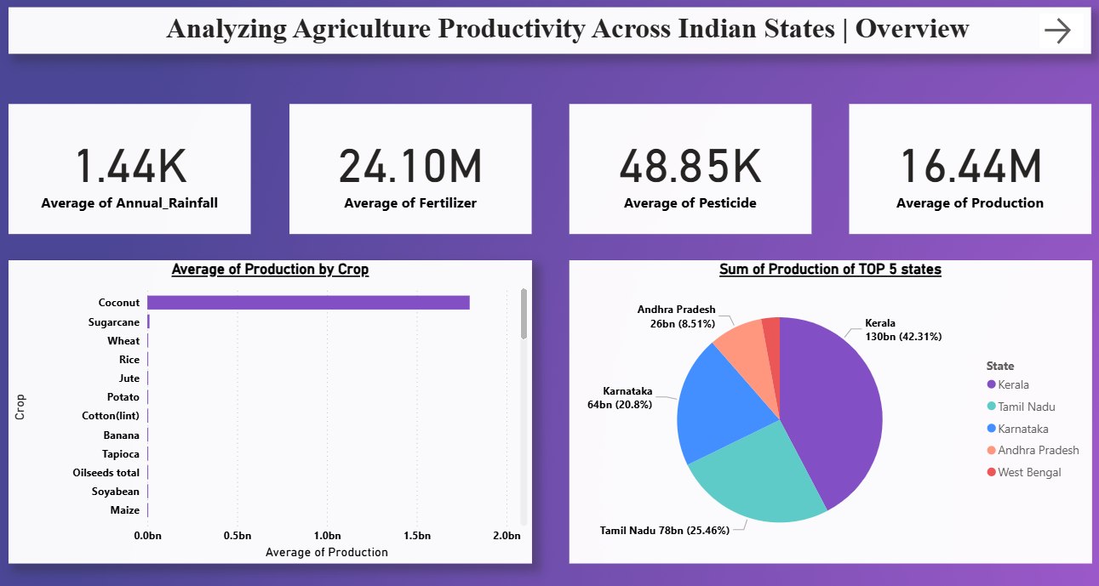
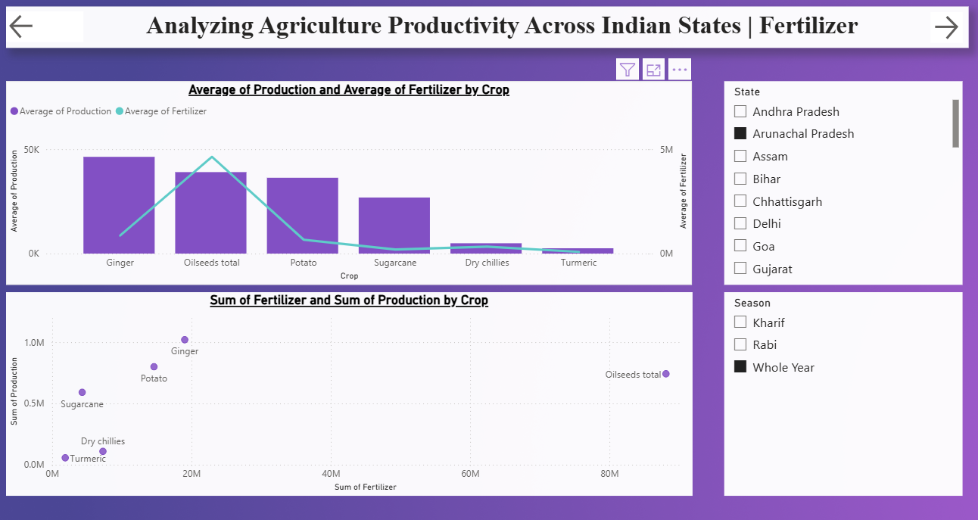
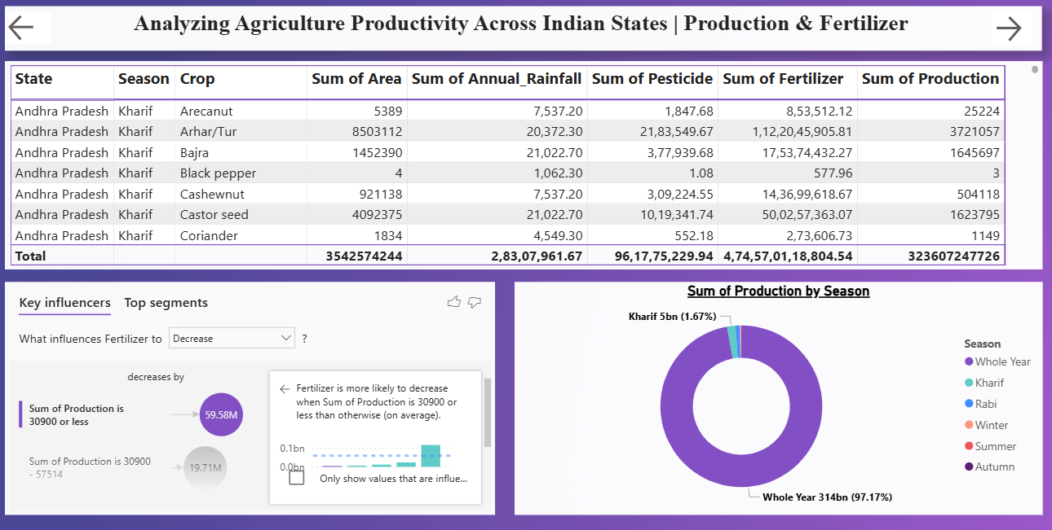
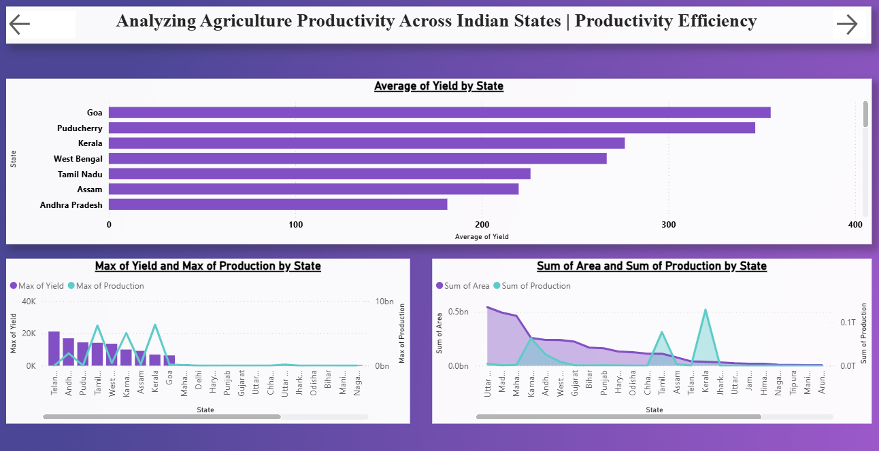
Screenshot of Output:
Dashboard-1
Dashboard-2
Dashboard-3
Dashboard-4

Slide 8
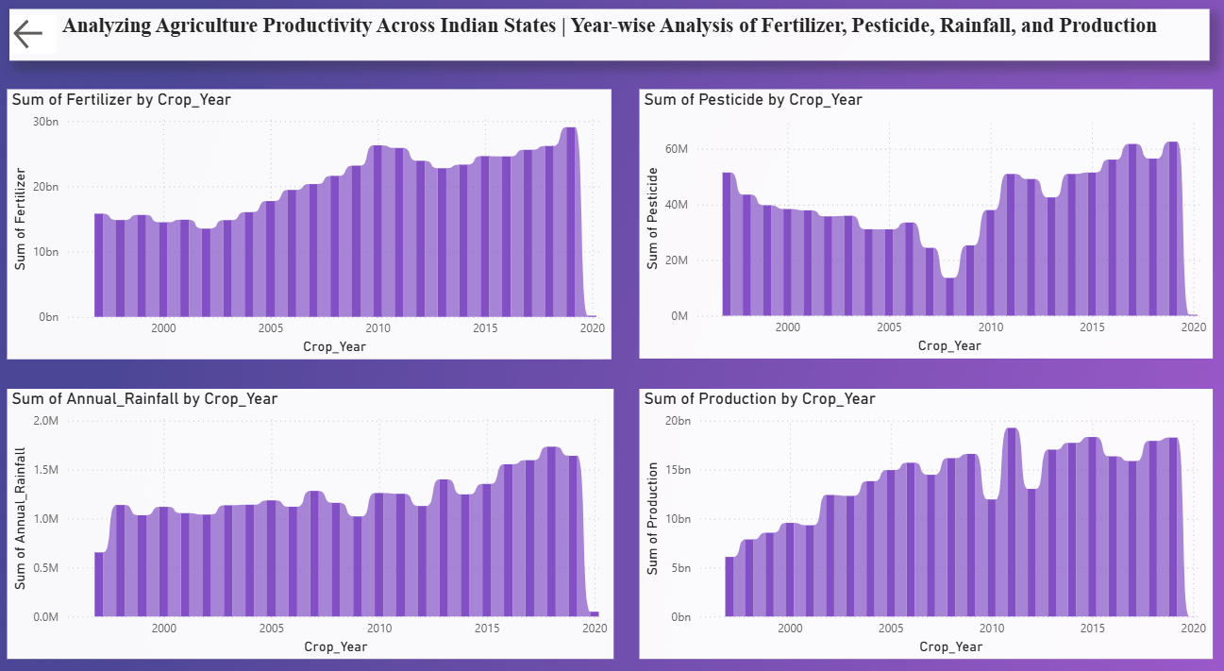
Dashboard-5

Slide 9
Conclusion:
The project successfully demonstrated how Power BI can be used to visualize and analyze agricultural productivity across Indian states. Through a step-by-step approach—starting from data loading to building insight-driven dashboards—the project highlighted key patterns in input usage and productivity trends. The final output not only improved data interpretation skills but also showcased the value of visual storytelling in uncovering actionable insights from complex datasets. The dashboards created provide a clear and interactive way to explore agricultural performance, which can guide informed decision-making. This project also set the foundation for more advanced analyses and visualizations in the future.
Github-Repository Link

